Slide 1
Creating a Fortress in Your Active Directory Environment
David Rowe @customes
david_rowe [@] Harvard.edu
#infosec #blueteam #security
©2019

Slide 2
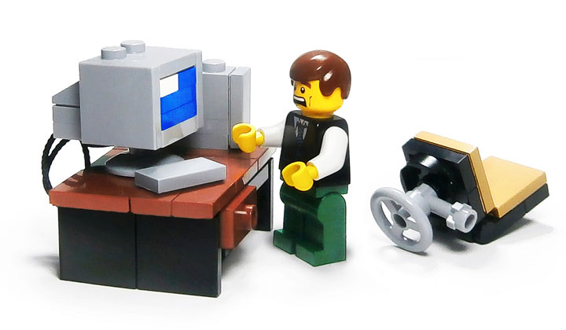
Cached Story
How many stored passwords is too many?
How long are they stored?
Notes:
The thing that bothers me, is that I logged into a computer… years ago. It remembered my password. I logged into it with an old password, like really old. The computer wasn’t even on the network. I.T. asked me to log into it because they needed to get something off of it. Who can use this password? Who can pretend to be me?

Slide 3
David Rowe
Active Directory (AD) Engineer @ Harvard University
Results from 16 pen tests focused on AD Access Paths
Audited 520,000+ objects across Harvard University
1350+ Group policies

Slide 4
What is Active Directory?
Active Directory is a hierarchical structure that stores information about objects on a network
Users
Computers
Groups
Dictates security through object ownership and group membership

Slide 5
Why access is important
Active directory is set up as a discretionary access control model
Based on the individual
Each person has an account
Accounts have access to objects
Notes:
Discretionary access control:
Each user has an account.
Each User is a member of groups
Groups access objects; Computers, Groups and users

Slide 6
Why access is important
RBAC
As administrators shift and rotate roles, they create different role groups with different access across the domain(s)
Ex: Helpdesk – reset passwords
Ex: Server Team – log on to servers
Privilege creep
Over time accounts gain more and more to objects.
The rights are often overlooked and unknown by owners of AD
Notes:
Discretionary access control:
Each user has an account.
Each User is a member of groups
Groups access objects; Computers, Groups and users

Slide 7
Why access is important
With users gaining more and more access to objects; computers, groups and other users, attackers have more areas to exploit
Notes:
Discretionary access control:
Each user has an account.
Each User is a member of groups
Groups access objects; Computers, Groups and users

Slide 8
For this Presentation - Keep in mind
There is a greater number of users on every domain that have privileged access than you can guess
User rights, once granted, sit idle and can be used by anyone with access to that account, group, or computer
Notes:
Discretionary access control:
Each user has an account.
Each User is a member of groups
Groups access objects; Computers, Groups and users

Slide 9
Cached Creds Defined
Computer level setting:
Interactive logon: Number of previous logons to cache [store in memory] (in case domain controller is not available) 1
Value indicates stored users credentials on device – (10)
Default stored as RC4 hash on system2
Ref: 1. https://docs.microsoft.com/en-us/windows/security/threat-protection/security-policy-settings/interactive-logon-number-of-previous-logons-to-cache-in-case-domain-controller-is-not-available
2. https://adsecurity.org/?p=556

Slide 10
Cached Creds Vulnerabilities
Targeted Pass-the-hash -If you can’t crack it, encapsulate and pass it
RC4 Nomore – one type of RC4 Exploit – 52 Hrs to crack
Rainbow tables –When I was in one incident response team I observed evidence a plaintext password 9 minutes after the hash was compromised

Slide 11
Kerberos
Provides the default authentication services and the authorization data
Necessary for a user to access a resource
Notes:
Add three and label with correct stuff

Slide 12
Kerberos Policy
Encryption Type | Server 2000 | Win XP | Server 2003 | Vista | Server 2008 | Windows 7 | Server 2008 R2
DES_CBC_CRC | O | O | O | O | X | X | X
DES_CBC_MD5 | O | O | O | O | O | X | X
RC4_HMAC_MD5 | O | O | O | O | O | O | O
AES128_HMAC_SHA1 | X | X | X | O | O | O | O
AES256_HMAC_SHA1 | X | X | X | O | O | O | O
Ref: https://goo.gl/UebQPs
Notes:
Add three and label with correct stuff

Slide 13
Microsoft’s Solution – ESAE
Enhanced Security Administrative Environment
Helps prevent compromise of administrative credentials from cyber-attacks
Thwart attacks by limiting exposure of admin credentials (Cached Credentials)
Microsoft’s recommended baseline to remediate pass the hash
Source:
https://goo.gl/UqHTJA
Notes:
Enhanced Security Administrative Environment (ESAE)
Attack detection – logging, ATA
https://adsecurity.org/wp-content/uploads/2017/11/BlueHat-2017-Metcalf-ActiveDirectorySecurityTheJourney-Final.pdf
https://github.com/clong/DetectionLab

Slide 14
Microsoft’s Solution – 3 Stages, 14 steps
Stage # | Step | Imp. Cost/Ops Maint Cost
1**** | Separate Admin accounts for Workstations | $/$
1**** | Separate Admin accounts for Servers | $/$
1**** | Separate Admin accounts for Domain Controllers | $/$
2 | Privileged Access Workstations for Admins | $$/$$$
2**** | Unique Local Passwords for Servers & Workstations | $/$
2 | Time Bound Privileges | $$/$$$
2 | Just Enough Administration | $/$$
2**** | Lower Attack Surfaces of DCs – Limit Admin Count | $/$
2**** | Attack Detection | $$/$$
Notes:
Enhanced Security Administrative Environment (ESAE)
Attack detection – logging, ATA
https://adsecurity.org/wp-content/uploads/2017/11/BlueHat-2017-Metcalf-ActiveDirectorySecurityTheJourney-Final.pdf
https://github.com/clong/DetectionLab

Slide 15
Microsoft’s Solution – 3 Stages
Stage # | Step | Imp. Cost/Ops Maint Cost
3* | Modernize roles and delegation model to be compliant with the tiers | $$/$$
3 | Smartcard authentication for all admins | $$$/$
3 | Admin Forest for AD admins | $$/$$
3 | Windows Defender Device Guard | $$/$$
3 | Shielded VMs | $$/$$

Slide 16
Takeaway
Without spending a single dollar:
An Active Directory Domain’s security footprint can be massively increased
in an hour
100% of Stage 1
50% of Stage 2
Notes:
100% of stage 1
50% of stage 2
Removing cached credentials
Separate admin accounts for DA, admins and workstation admins
Unique local computer passwords
Limit number of administrators
Audit and alert! - powershell

Slide 17
1 Day Security Solution
Limit the number of administrators
Create separate admin accounts and block admins logon access to workstations and servers
Remove cached credentials from workstations and servers
Unique local computer passwords
Audit and alert
Supporting Toolset
https://github.com/davidprowe/AD_Sec_Tools

Slide 18
The Breach
An unpatched public facing web server was compromised
An attacker exploited a vulnerability, granting admin access to the server (#5!)
The attacker dumped the cached credentials on the server, finding a local administrator password identical across machines (#4! & #3!)
Attacker moved laterally across the domain probing servers until he/she finds a computer where a domain administrator (DA) credential was stored (#2! & #1!)
Attacker dumps DA hash from machine and cracks it
The attacker now as full administrative access on the domain
Notes:
Add three and label with correct stuff

Slide 19
#1 Limit Admins – Quick Win
Boot people out of admin groups
Boot SAs out of groups
Boot groups out of groups
Centralize administrative accounts

Slide 20
Simple Deploy – 1. Boot People
What are admin groups on the domain?
Built-in Groups
Shadow Admins

Slide 21
Built-in Groups’ Rights Overview
Account Operators: Read LAPS attribute, administer domain user and group accounts
Administrators: Complete and unrestricted access
Backup Operators: Override security restrictions for the sole purpose of backing up or restoring files. Allow Logon Locally, log on as batch job, shut down the system
Domain Admins: member of every domain-joined computer’s local Admin group
Enterprise Admins: permissions to change forest-wide configuration settings. Member of every domain’s Administrator group
Group Policy Creator Owners: Can create and modify GPOs on the domain
Notes:
Add three and label with correct stuff

Slide 22
Built-in Groups’ Rights Overview
Schema Admins: make modifications to the AD Schema
Server Operators: can administer domain servers
Remote Desktop Users: Members of this group can remotely log on to domain controllers in the domain. This group has no default members
Organization Management: This is a RBAC group for MS Exchange Server. Members have admin access to the entire Exchange organization, including modifying membership of other exchange groups
Notes:
Add three and label with correct stuff

Slide 23
What is a Shadow Admin?
A shadow admin is an account in your network that has sensitive privileges. Typically overlooked because the account is not in a privileged group, permissions for this account were granted directly using ACLs on AD objects.
These accounts are highly desirable because they provide admin privileges needed to advance an attack. They are less likely to be watched by audit and logging systems
Example:
Attacker steals Field Tech’s credential
Finds Groups where stolen credential has access to modify other objects
Attacker hijacks those objects
Attacker continues to elevate privileges to Tier 0
Notes:
Add three and label with correct stuff

Slide 24
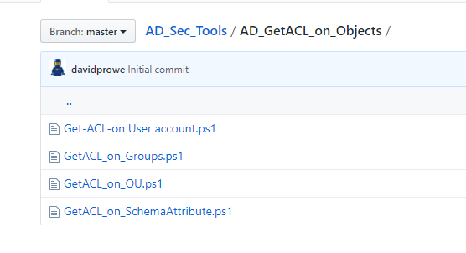
Finding Shadow Admins
See GIT - Updated ACL scripts
Source: https://gallery.technet.microsoft.com/Active-Directory-OU-1d09f989
Notes:
Add three and label with correct stuff

Slide 25
Why find and limit # of admins
These are:
The accounts the attackers are targeting.
The credentials they want
The credentials laying dormant on systems
These are the groups where you need to require separate administrative accounts
Notes:
Add three and label with correct stuff

Slide 26
#2 Admins – Quick Win
Separate admin accounts
Block login access across tiers
Move Admin users and groups to Admin OU

Slide 27
Simple Deploy – 2. Block Admins
Create separate administrator accounts – built-in and shadow admins
Don’t forget to create accounts for the helpdesk!

Slide 28
Tiered Guidelines
Tier 0
Domain Admins
Accounts which have the ability to manage identity and permissions enterprise-wide.
Objects: Domain Controllers and systems that manage DCs
Tier 1 Server Admins
Accounts with control over resources or that manage critical data and applications.
Objects: Servers
Tier 2 Workstation Admins
Accounts with administrative privileges over standard user accounts and standard-user devices.
Objects: Workstations

Slide 29
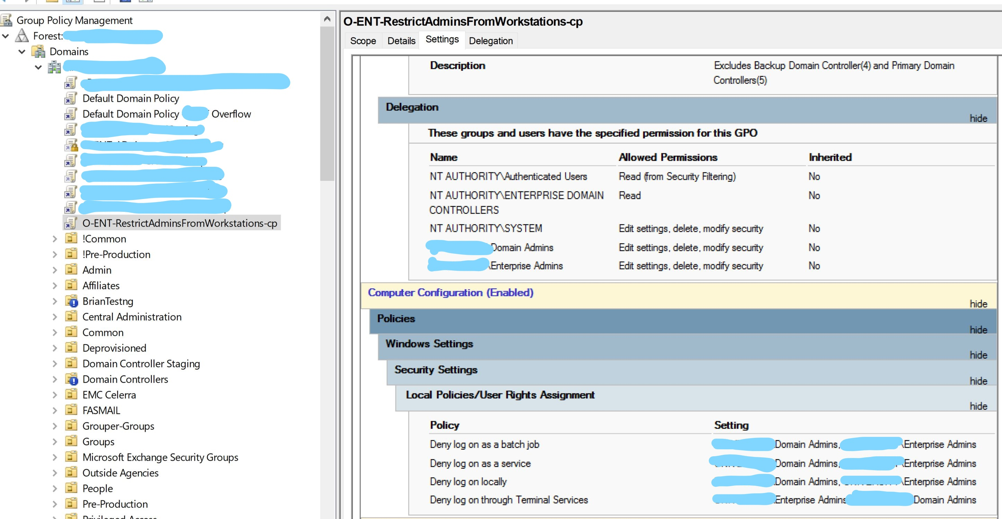
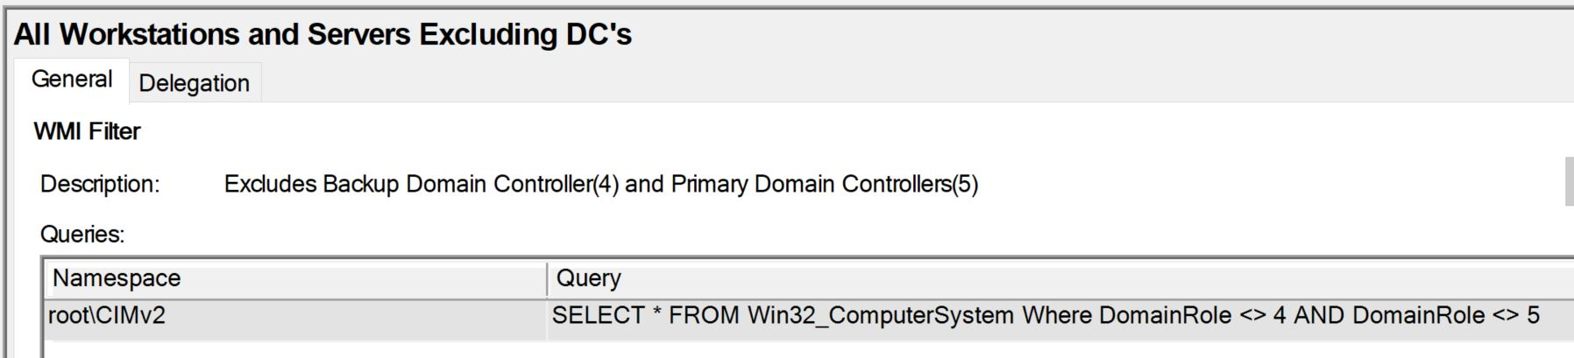
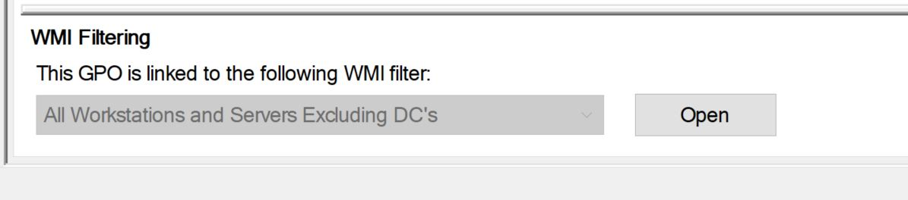
Block Admins: The GPO: Servers

Slide 30
Simple Deploy – 3. Cached Creds GPO
Create GPOs to remove the cached credentials from computers
…then reboot

Slide 31
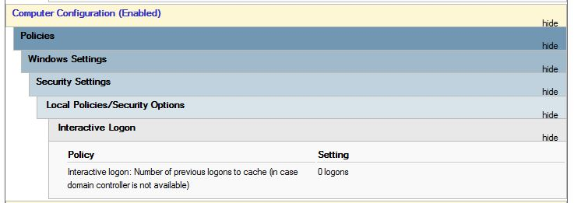
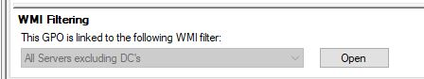
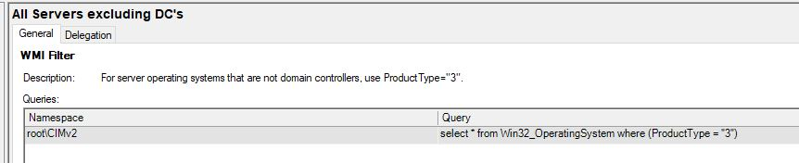
Cached Creds: The GPO: Servers
Notes:
Implement, REBOOT

Slide 32
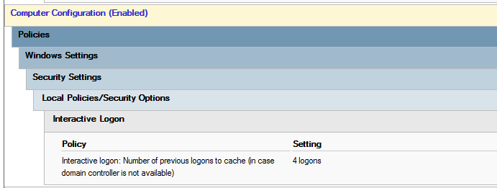
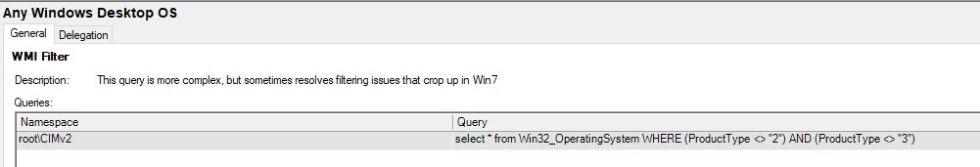
Cached Creds: The GPO: Desktops
Notes:
Implement, REBOOT

Slide 33
Common tools to exploit Cached Creds
Mimikatz
JtR
Hashcat
Ophcrack
Taskmanager… + lsass.exe
Pwdumpx + passwordPro
Notes:
Dump clear-text passwords from memory using mimikatz and the Windows Task Manager to dump the LSASS process.
To do this, dump the lsass.exe process to a file using Windows built-in Task Manager with right-clicking “lsass.exe” then selecting “Create Dump File”

Slide 34
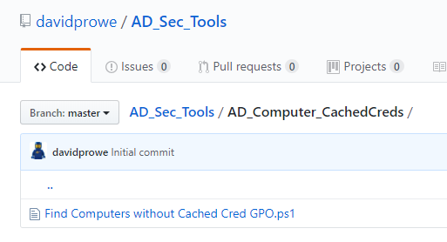
Report on your domain’s cache settings
Find machines on the domain that have cached creds enabled
*AD_Computer_CachedCreds\Find Computers without Cached Cred GPO.ps1
Notes:
Dump clear-text passwords from memory using mimikatz and the Windows Task Manager to dump the LSASS process.
To do this, dump the lsass.exe process to a file using Windows built-in Task Manager with right-clicking “lsass.exe” then selecting “Create Dump File”

Slide 35
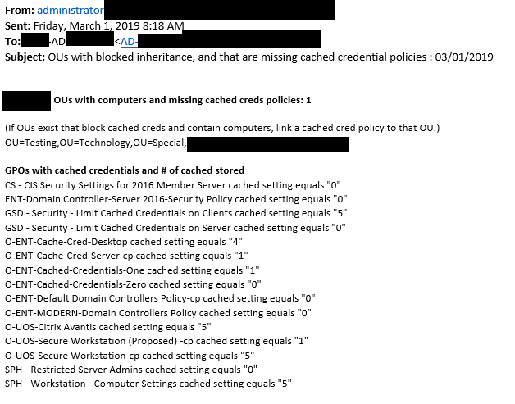
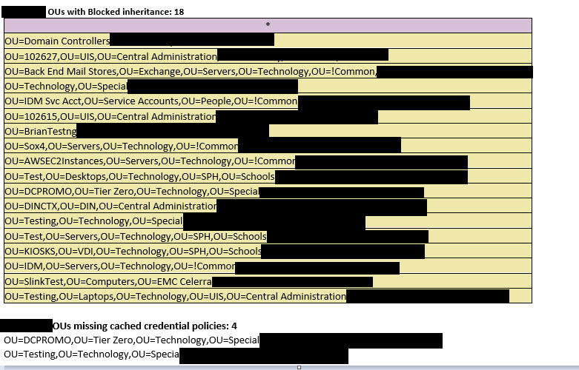
Report on your domain’s cache settings
Notes:
Dump clear-text passwords from memory using mimikatz and the Windows Task Manager to dump the LSASS process.
To do this, dump the lsass.exe process to a file using Windows built-in Task Manager with right-clicking “lsass.exe” then selecting “Create Dump File”

Slide 36
Simple Deploy – 4. LAPS
Unique passwords for all workstations and servers
Local Admin Password Solution – ms-mcs-admpwd, …expirationtime
Prevents lateral movement between machines
More info: https://adsecurity.org/?p=3164

Slide 37
LAPS
4 Things needed for LAPS to work.
Extend schema on the domain to support LAPS *
Allow computers on the domain to write LAPS attribute *
Software must be installed on workstations/servers
GPO to deploy password settings
*\AD_Sec_Tools\AD_LAPS_Install

Slide 38
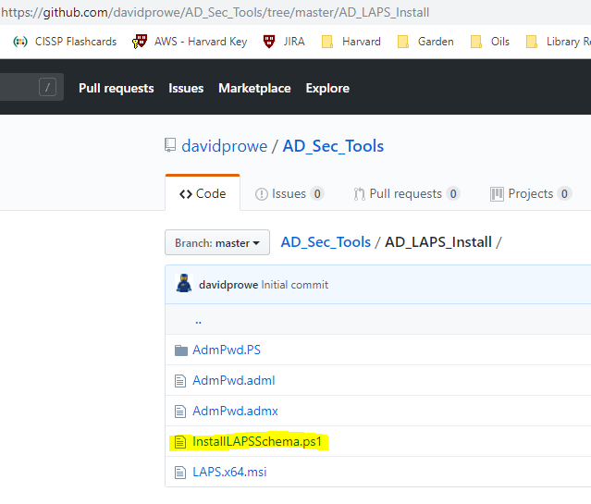
LAPS: Reqs #1 and #2

Slide 39
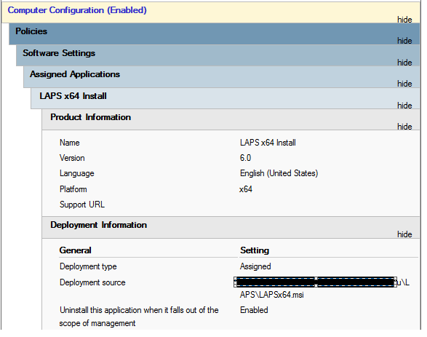
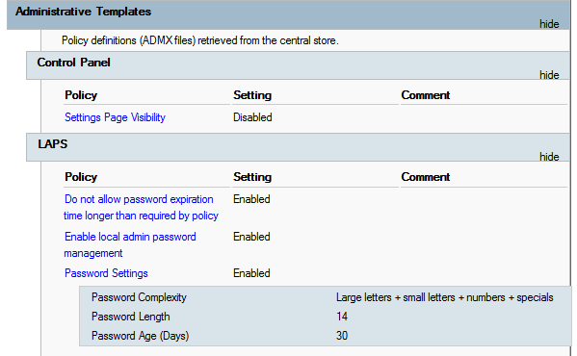
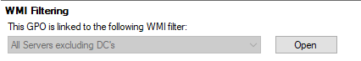
LAPS: Reqs #3 and #4

Slide 40
Simple Deploy – 5. Audit and Alert
Audit
Alert
Domain Admin logon
Alert of vssadmin create shadow
Install Security Tools
Notes:
There are ways around the vss copy, but those methods include another form of elevation on the computer. Typically elevating to system. If you have auditing and alerting turned on for special logons, this should trigger an alert.

Slide 41
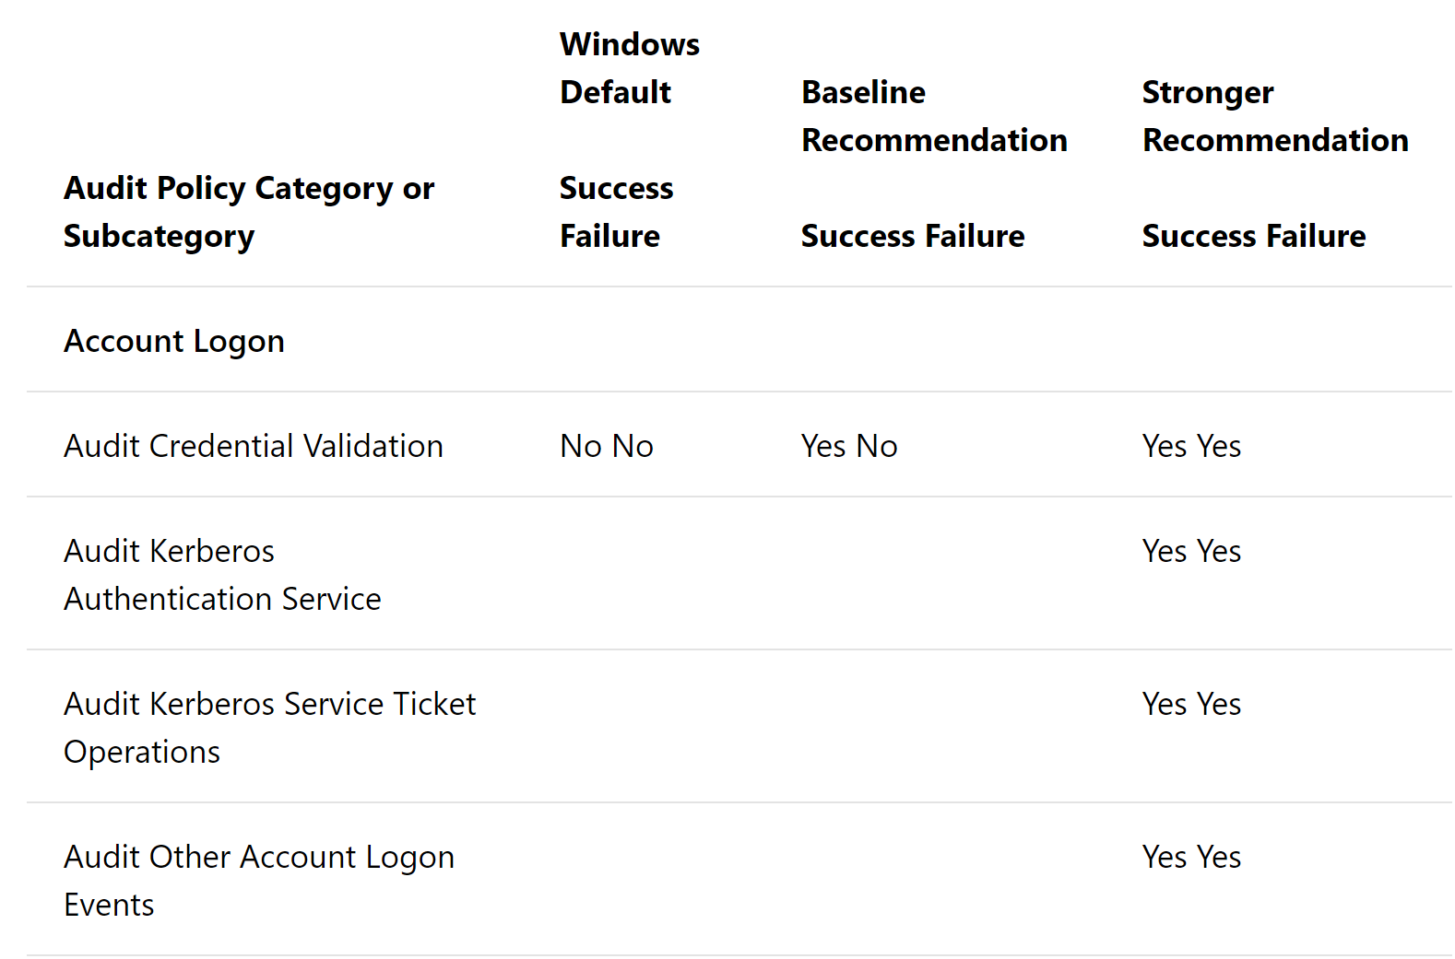
Audit
MS Audit Policy Recs: https://goo.gl/uGUL4a
Sample:

Slide 42
Alert
Domain Admin logons
Vssadmin create shadow on domain controllers
Protect the NTDS.dit
Move the NTDS.dit
Domain dumps often start with the vss copy
Notes:
There are ways around the vss copy, but those methods include another form of elevation on the computer. Typically elevating to system. If you have auditing and alerting turned on for special logons, this should trigger an alert.
Event ID 8193 – vss started

Slide 43
Security Tools
Endpoint Protection –
Gartner link https://goo.gl/NgWuGK
Crowdstrike
CarbonBlack
Cylance
Sophos
Fireeye
Notes:
There are ways around the vss copy, but those methods include another form of elevation on the computer. Typically elevating to system. If you have auditing and alerting turned on for special logons, this should trigger an alert.

Slide 44
Groups with ACL permissions on Domain
*DOMAIN\IT USERS *DOMAIN\HR USER MANAGEMENT *DOMAIN\IT - HELP DESK *DOMAIN\ACCOUNT MANAGEMENT *DOMAIN\IT Exchange *DOMAIN\IT User Password Resets *DOMAIN\IT SERVER ADMINS *DOMAIN\Enterprise Services *DOMAIN\Office dept Admins *DOMAIN\Base Admins *DOMAIN\Comp Management *DOMAIN\EMAIL ADMINS *DOMAIN\CONTACT CREATOR *DOMAIN\ContactManagement *DOMAIN\Credit_SUPPORT *DOMAIN\Web Administration *DOMAIN\MAILBOX MGMT *DOMAIN\Service Desk *DOMAIN\O ADMINS *DOMAIN\VPN Administrators *DOMAIN\AD User Cleanup *DOMAIN\RESEARCH ADMINS
*DOMAIN\Epsilon Admins *DOMAIN\Zone ADMINS *DOMAIN\ADWRITERS Admins *DOMAIN\File Share ADMINS *DOMAIN\R drive ADMINS *DOMAIN\O drive ADMINS *DOMAIN\SAN Admins *DOMAIN\Medical APPLICATION ADMINS *DOMAIN\SERVICE NOW ADMINS *DOMAIN\SERVICE NOW OU ADMINS *DOMAIN\SERVICE NOW Group ADMINS *DOMAIN\IT OU ADMINS *DOMAIN\Network Team *DOMAIN\Cluster2 Admins *DOMAIN\Database Disk Admins *DOMAIN\Cluster Admins

Slide 45
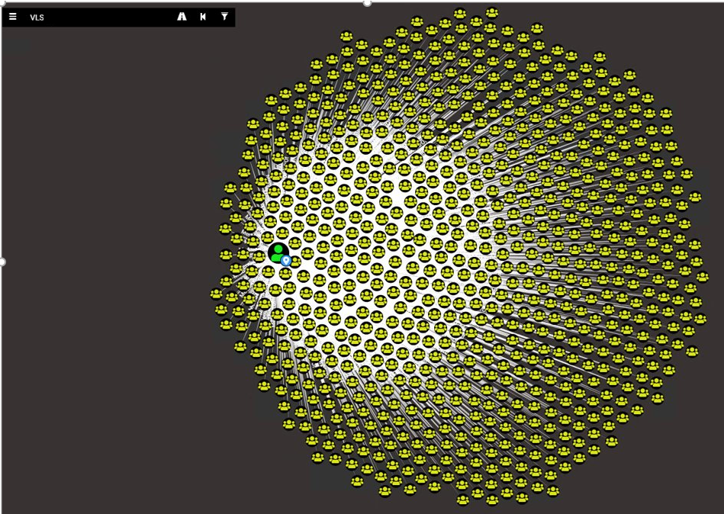
Excessive Group Membership Example: Epic Sunflower
Notes:
Add three and label with correct stuff

Slide 46
Questions?
https://github.com/davidprowe/AD_Sec_Tools
@customes
david_rowe [@] Harvard.edu
Notes:
Add three and label with correct stuff

